Slide 1
House Price Prediction
Presenters:
Hamza Majeed
Abdul Wahab
Hafsa Najeeb

Slide 2

Problem Statement
“Predicting house prices accurately is challenging due to factors like location, size, market trends etc. Our goal is to create a user-friendly machine learning model that considers these aspects to provide reliable price estimates. This tool aims to support buyers and sellers in making well-informed decisions in the housing market.”

Slide 3
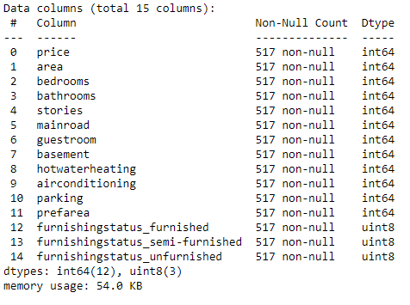
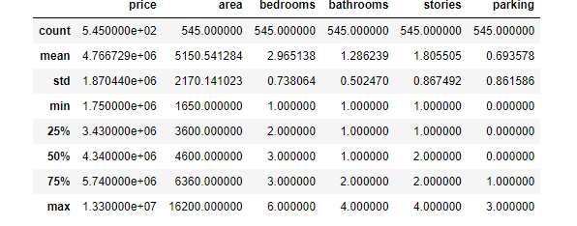
Dataset Information
Source: Kaggle
Features:15
Records: 545
Data Frame Summary:

Slide 4

Data Preprocessing & Transformation
Data Cleaning
Handling Missing Values
Handling Duplicates Values (Dropped)
Outlier Detection and Treatment (IQR)

Slide 5
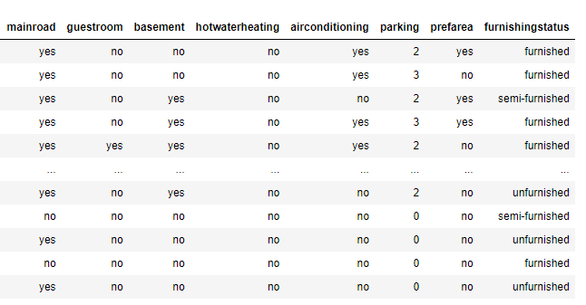
Data Preprocessing & Transformation
Data Transformation
Binary Encoding
One Hot Encoding
Standardization

Slide 6
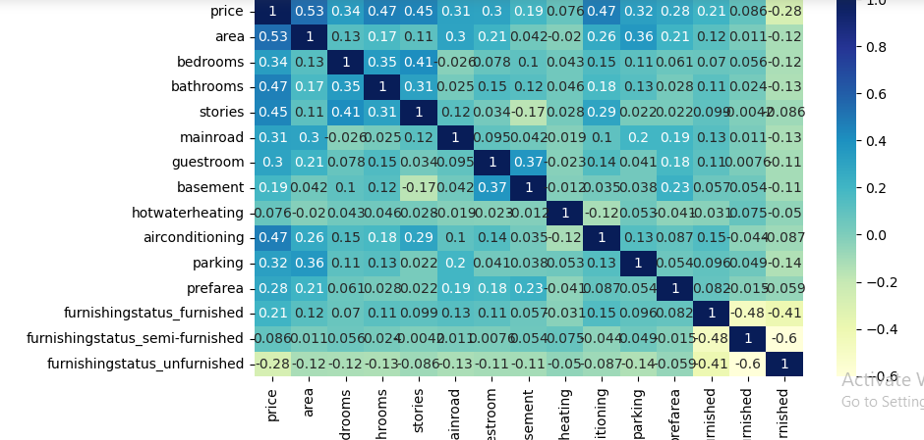
Feature Selection
PCA is used for feature selection after testing with other techniques like Wrapper method , Pearson correlation etc.

Slide 7

ML Modeling
Linear Regression with ridge regularization is used.
Other Models Tested:
Support Vector Machines(SVM)
Random Forest Regressor with different depths.
Data Splitting :
For testing: 75%
For Training : 25%

Slide 8

Results
R-squared: 0.77
Mean Absolute Error: 470526.93
Mean Squared Error: 971719806.20
Root Mean Squared Error: 597131.75

Slide 9


